Slide 1
Wait, what?
Who am I and what is this?

Slide 2


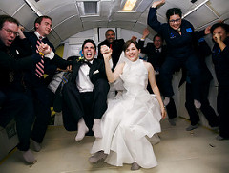


Erin Finnegan

Slide 3
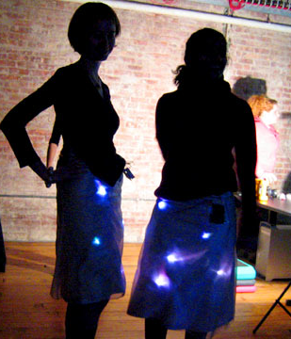
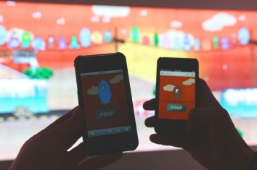

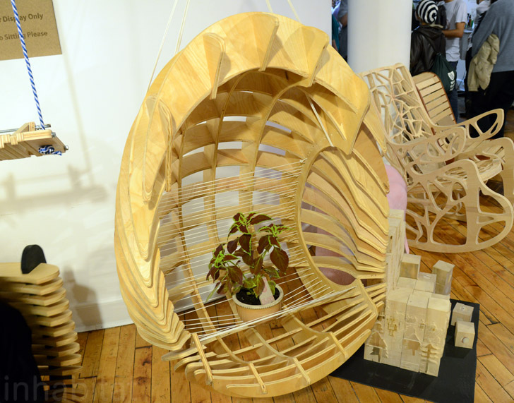


Slide 4
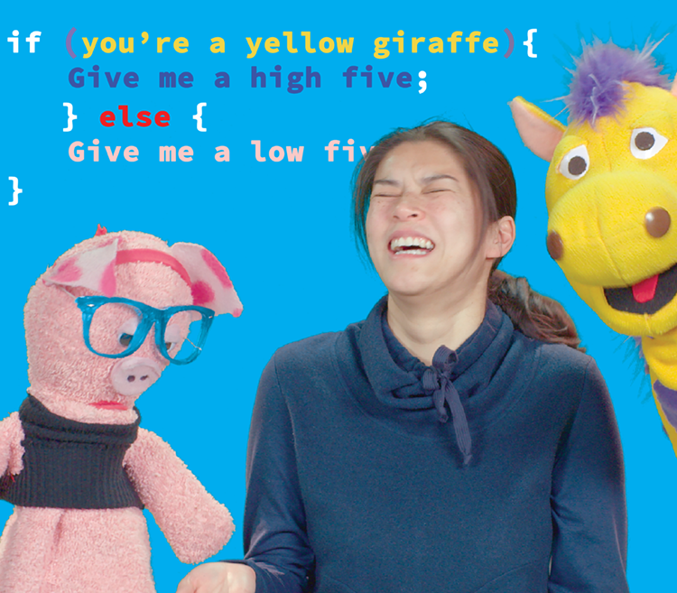
hello-world.tv

Slide 5
Is this an audition or a meet-up or a class or what?

Slide 6
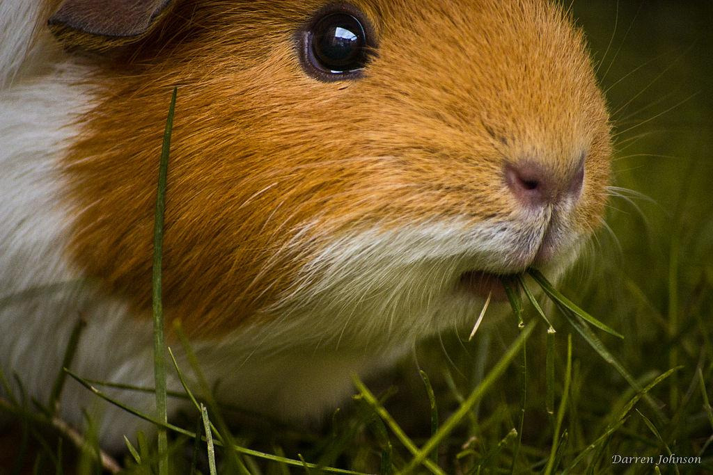
It can be two things

Slide 7
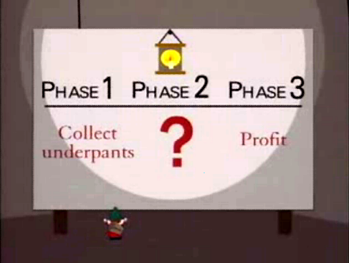

Slide 8
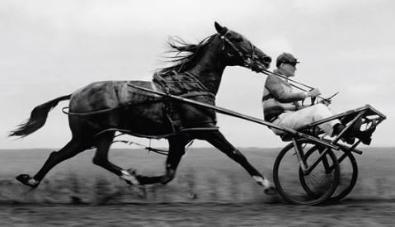
form a team
raise money
shoot more footage
raise more money

Slide 9
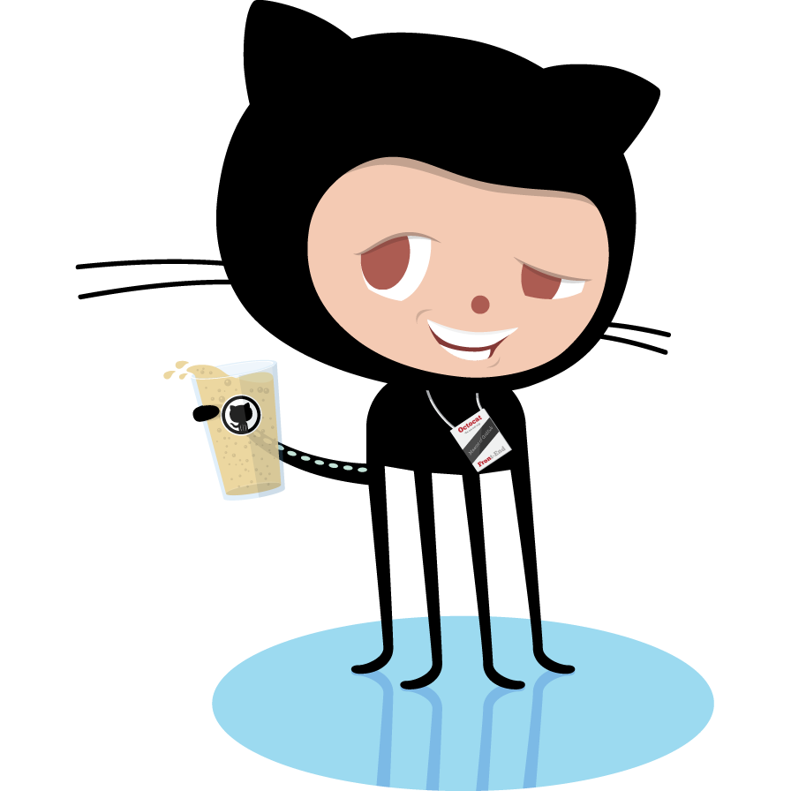
What about my IP?
Notes:
Can you recommend an IP lawyer? What would an open source TV show look like? No one wants to work for free or for credit?

Slide 10
a + 1 = 2
What’s a variable?
Notes:
in math, solving for the unknown

Slide 11
x = awesome
variables in computer programming
Notes:
From Wikipedia: The variable name is the usual way to reference the stored value; this separation of name and content allows the name to be used independently of the exact information it represents. The identifier in computer source code can be bound to a value during run time, and the value of the variable may thus change during the course of program execution.

Slide 12
x =
1600 pixels, 255 colors, cats, where the mouse is pointing, your name, the money in your bank account, the position of your hand in front of the Kinect, your score in Two Dots

Slide 13
x =
???
Notes:
Brainstorm some stuff we use variables for that are awesome

Slide 14
examples in Processing and Scratch

Slide 15
Character Development
INT, STR, WIS, DEX
speech
thought, deed, action
kicking puppies, etc.
appearance
fatal flaw
Notes:
Brainstorm some stuff we use variables for that are awesome

Slide 16
Rapid Character Development
Shape: Animal? Human? Abstract?
# of limbs?
talent?
hobby?

Slide 17
Rapid Character Development
Groups of 3
5 minutes per round

Slide 18
Learn More
https://github.com/ITPNYU/ICM-2015
http://processing.org
https://www.codecademy.com/
https://scratch.mit.edu/
http://jsforcats.com/
for free

